Slide 1
CROP RECOMMENDATION
Under the guidance of
Ms. MANALI PATIL
Email:manalivikas.patil@anudip.org
Presented by
G.SREELAKSHMI
Batch Code:ANP-C7332,
STUDENT ID:AFO366836

Slide 2

Contents
Abstract
Introduction
Objective
Applications
Data Collection
Software Requirements
Analysis of Crop Recommendation
Applications
Conclusion

Slide 3
Abstract
In agricultural practices, selecting appropriate crops suited to the prevailing environmental conditions is crucial for maximizing yield and ensuring sustainable production. This study employs data analysis techniques to recommend suitable crops based on environmental factors such as temperature and humidity. A dataset containing information on various crops, including rice, jute, cotton, maize, and lentil, is analyzed using Python programming language and Plotly visualization library. The dataset is filtered to include only relevant crops, and a scatter plot is generated to visualize the relationship between temperature, humidity, and crop types. Through this analysis, insights are derived regarding the temperature and humidity preferences of each crop type, clustering patterns, outlier detection, and the overall relationship between environmental variables and crop selection. These findings provide valuable guidance for agricultural practitioners in making informed decisions regarding crop selection, optimizing resource allocation, and enhancing agricultural productivity in diverse environmental conditions.

Slide 4
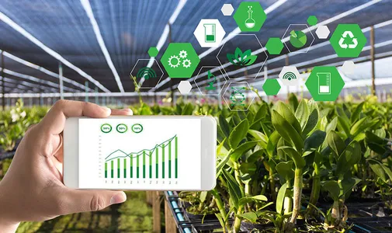
Introduction
A crop recommendation system is a tool that helps farmers make informed decisions about the crops they should grow. The system considers various factors such as climate, soil type, irrigation, and market demand to provide personalized recommendations to farmers.
Crops are plants, or products made from plants, that are grown and harvested for subsistence or for profit.
Crop Recommendation System takes the N-P-K (Nitrogen, Phosphorous and Potassium) and pH values along with the temperature, humidity values as input and recommends the optimal crop to the farmer, hence ensuring that the farmer takes an informed decision before cultivation.

Slide 5
Objective
Maximizing Yield: Help farmers choose crops that grow well in their area's weather, soil, and nutrient conditions, ensuring they get the most produce possible from their land.
Using Resources Efficiently: Recommend crops that need less water, land, and nutrients, so farmers can save resources and protect the environment.
Reducing Risks: Suggest a variety of crops that can handle different problems like pests, diseases, or bad weather, reducing the chance of all crops failing at once.
Promoting Sustainability: Encourage farmers to grow crops in ways that keep the soil healthy, increase biodiversity, and make farms more resilient to changes in climate or pests.
Empowering Farmers: Give farmers the tools and information they need to make smart choices about what to grow and how to grow it, so they can run successful farms and support their families.

Slide 6
Data Collection
Kaggle is a data science competition platform where users can find datasets to use, publish datasets, collaborate with other data scientists, and enter competitions.
GitHub has several free Excel datasets, including workbooks for Power BI and Power BI Desktop, as well as projects that help with data analysis.
A CSV (Comma Separated Values) file is a simple file format for storing tabular data. Each line of a CSV file is a data record, and each record contains one or more fields separated by commas.

Slide 7
Software Requirements
Python:
Python serves as the primary programming language due to its extensive libraries for data
manipulation, analysis, and machine learning. Popular libraries for heart attack prediction
include:
Pandas: For data manipulation and preprocessing.
NumPy: For numerical operations and array manipulation.
Scikit-learn: For machine learning algorithms and model evaluation.
Matplotlib and Seaborn: For data visualization.
Jupyter Notebook or Jupyter Lab:
Jupyter Notebook is a popular open-source web application that allows you to create and
share documents containing live code, equations, visualizations, and narrative text
Google Colab requires only a web browser and internet connection, as it runs entirely on Google's cloud infrastructure.

Slide 8
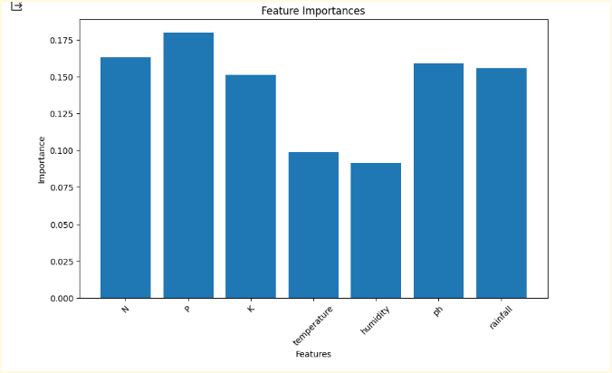
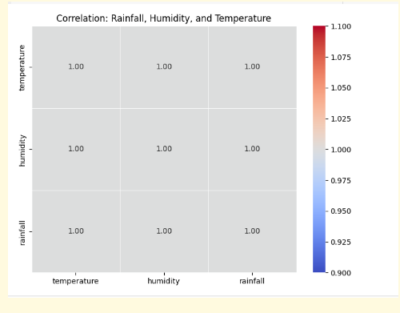
Analysis of Crop Recommendation

Slide 9
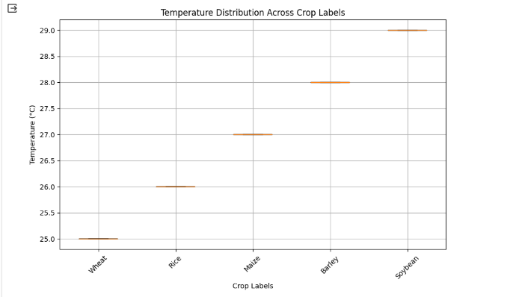
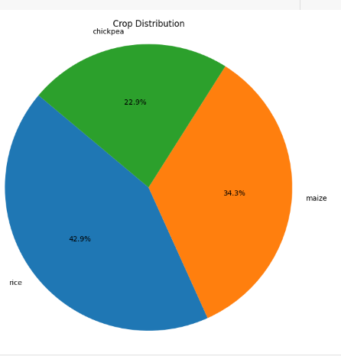

Slide 10
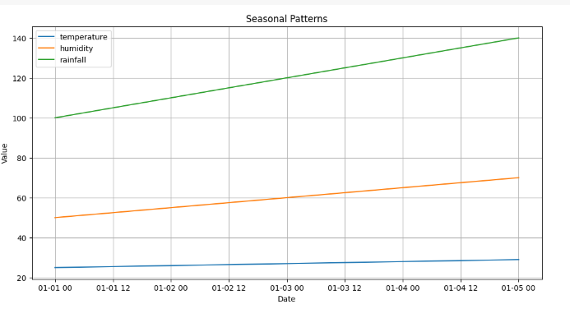

Slide 11
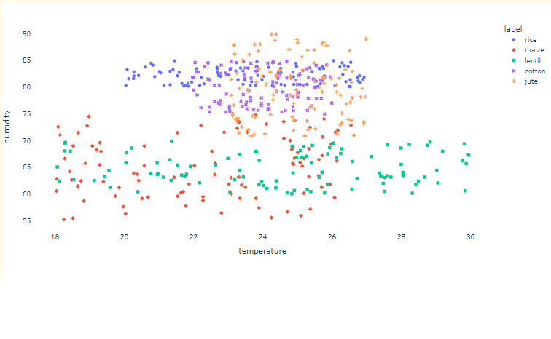

Slide 12
Applications
Precision Agriculture
Climate Change Adaptation
Crop Diversification
Sustainable Land Use
Smallholder Farming
Market Access and Value Chains

Slide 13
Conclusion
In conclusion, crop recommendation is a cornerstone of modern agriculture, offering invaluable insights and guidance to farmers in optimizing their crop selection and management practices. By harnessing advanced data analysis techniques and environmental data, farmers are empowered to make informed decisions that not only maximize yield but also minimize risks and promote sustainable agricultural practices.
In essence, crop recommendation represents more than just a means to increase yields; it is a pathway towards building more resilient, efficient, and sustainable agricultural systems. By embracing data-driven approaches and innovation, we can unlock the full potential of crop recommendation to address the challenges of the 21st century and beyond.

Slide 14
THANK YOU

